Slide 1
CSE 11 Accelerated Intro to Programming Lecture 11
Greg Miranda, Spring 2021
This lecture is being recorded

Slide 2
Announcements
Quiz 11 due Friday @ 8am
PA3 due tonight @ 11:59pm
Survey 4 due Friday @ 11:59pm
Week 6, 9, and finals week for take-home exams

Slide 3
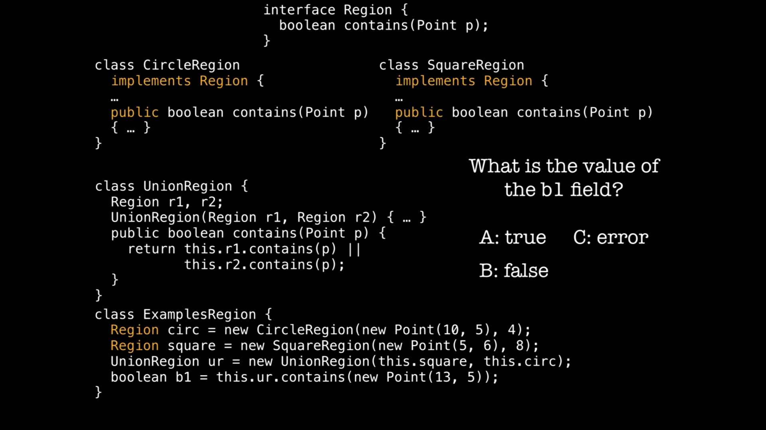


Slide 4
Using Interfaces
Add Region interface
Update RectRegion & CircRegion

Slide 5
Intersect Region
interface Region {
boolean contains(Point p);
}
class IntersectRegion implements Region {
Region r1;
Region r2;
IntersectRegion(Region r1, Region r2) {
this.r1 = r1;
this.r2 = r2;
}
public boolean contains(Point p) {
return this.r1.contains(p) && this.r2.contains(p);
}
}

Slide 6
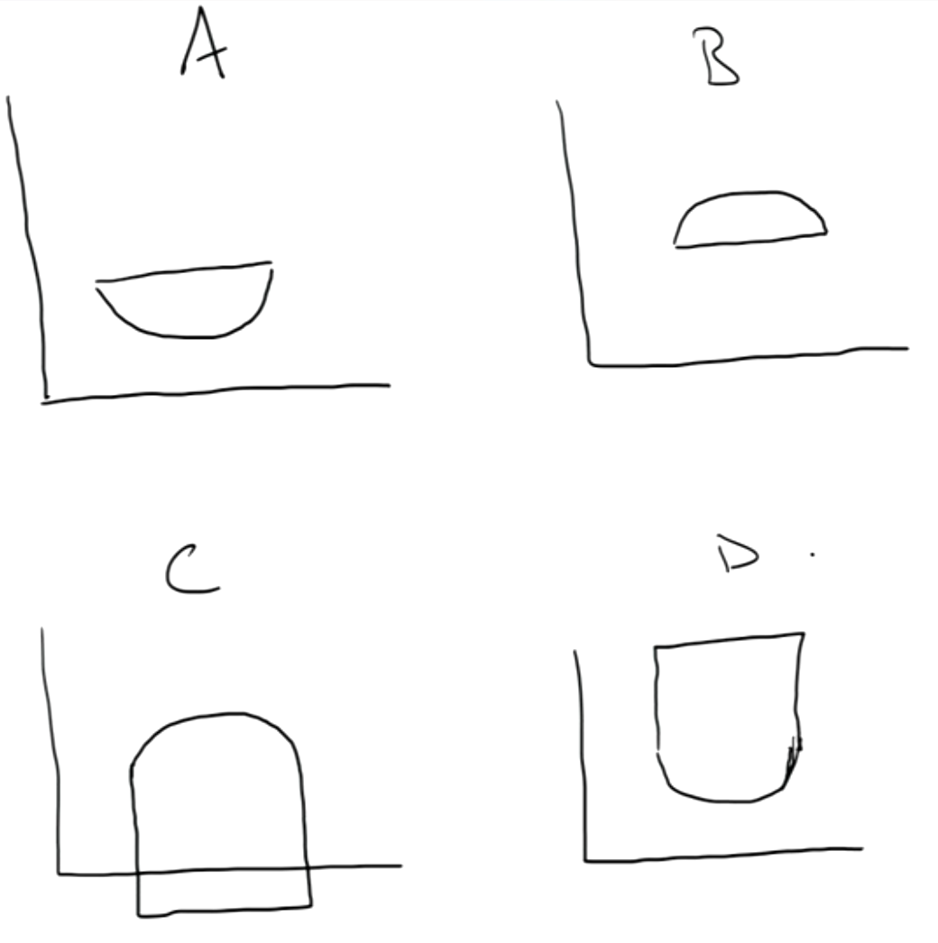



class IntersectRegion implements Region {
…
public boolean contains(Point p) {
return this.r1.contains(p) && this.r2.contains(p);
}
}
class ExamplesRegion {
Region circ1 = new CircleRegion(new Point(10, 5), 4.0);
Region sq = new SquareRegion(new Point(10, 1), 8.);
Region ir = new IntersectRegion(this.circ1, this.sq);
//What region is represented in toDraw?
Region toDraw = ir;
}

Slide 7

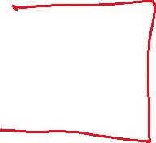





SubtractRegion
Write a new class called SubtractRegion
That also implements Region
Represents all the points in region1 that aren’t in region2
Start with a shape and subtract another shape from it
Subtract a circle from another circle to create a ring
Write the class
Fields and constructor
What does the contains method look like?

Slide 8

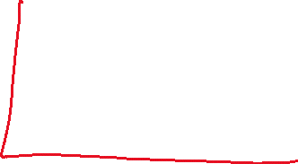


Something more complicated
What if we wanted a region that was 3 circles next to each other:
How could we construct an example of this?

Slide 9
Inheritance
New terms
abstract class
extends

